Slide 1
IBM Rational Rhapsody Advanced Systems Training v7.5
Parametric Modeling

Slide 2
SysML 1.0 for System Engineers
Parametric Modeling

Slide 3
Objectives
Define the basic concepts of:
  Constraints
  Data types
  Value types
  Constraint block
  Constraint property
Start a new Rhapsody parametric diagram project and add constraints, define attributes and constraints
Add dimensions, units and value types to the parametric diagram

Slide 4
Parametric diagrams
Graphical means of showing mathematical or logical relationships between model elements
  Generally used to model the physical characteristics of Systems:
    Energy, Weight, Stress, Displacement
Used in number of ways:-
  Analyze a systems mathematical behavior
  Understand the input → output relationship for a system
  Evaluate the systems capability to achieve its requirements (trade off analysis)

Slide 5
Basic concepts – Value Type
Data types in SysML may be modeled as simple types
  Example: an integer that has a value
SysML Value Types may have, in addition to the value:
  Dimension:
    Defines the fundamental ‘quantity’ (example: mass, length, time)
  Unit (of measure):
    A particular value in terms of which a quantity of the same dimension may be expressed (example: mm, metres)
For example, the dimension Length may be expressed in units of meters, km, or feet.
  It is possible to compare different units because they have the same underlying dimension (although a conversion would be required).
  It is possible to omit the unit in order to specify the dimension in an abstract form.

Slide 6
Basic concepts – Constraint Block
Constraint Blocks are the definitions of the systems mathematical or logical constraints
Constraint Blocks consist of:
  Constraint:
    Defines the mathematical or logical relationships between the Constraint Parameters, for example: F=M*A
    Note that there is no formal language to define the constraints.
  Constraint Parameters:
    Provide the binding between the inputs/outputs and the variables used in the constraint

Slide 7
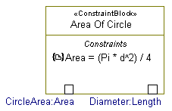
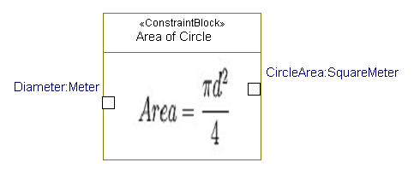
Constraint Block examples
Constraint
Constraint Parameter (abstract: typed only by dimension)
Constraint shown using Rhapsody image view
Constraint Parameter (with units specified)

Slide 8
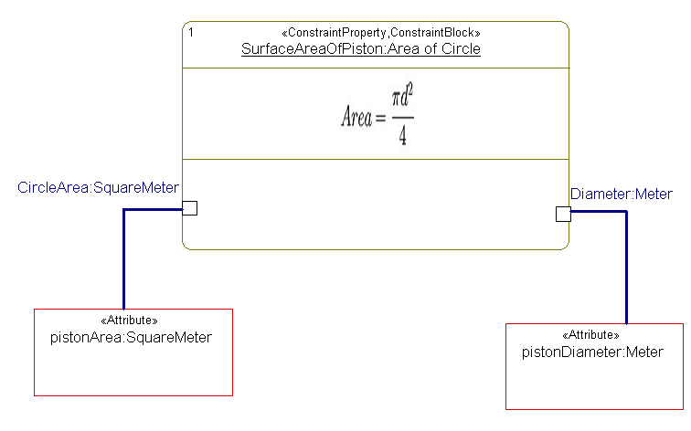
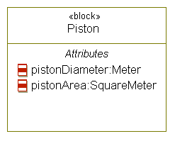
Basic concepts – Constraint Property
Constraint Properties are usages of Constraint Blocks:
  Constraint Properties are typed by Constraint Blocks.
  Constraint Properties must be owned by SysML Blocks.
  Binding Connectors bind parameters to properties in the surrounding context.
    For example attributes, other parameters, flow ports:

Slide 9
Generic versus specific Constraint Blocks
Constraint Blocks may be modeled:
  Specifically (example: Force = Mass * Acceleration)
    Needs an idea of how the Constraint will be used
    May use specific engineering types
    May lead to large libraries for basic calculations
  Generically (example: C = A * B)
    Cannot use engineering types
    Reusable

Slide 10
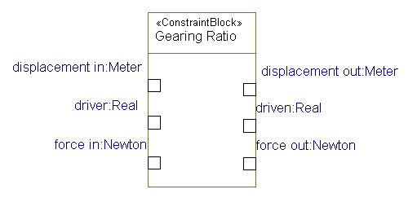
Structured Constraint Blocks
Constraint Blocks can contain Constraint Properties (typed by other Constraint Blocks)
  They decompose and make the analysis easier to understand
  See next page for Gearing Ratio internal view
Gearing Ratio (external view)

Slide 11
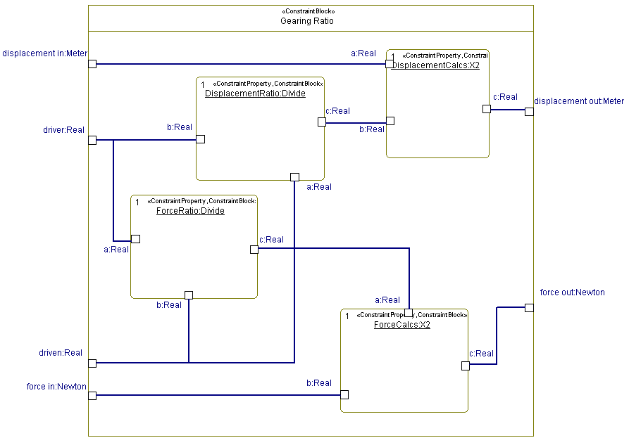
Structured Constraint Blocks example
Gearing Ratio (external view)
Gearing Ratio (internal view)

Slide 12
The practicalities of Parametric Diagrams
You need to know your engineering units
You need to extend the standard SysML SI definitions library for your own domain
You need to define Constraint Blocks for the correct level of analysis
  Constraint Blocks are non-causal
    Given a Constraint Block with the constraint F=MA
    Can it be used as A=M/F ?
  How is it to be used ?
    F=MA is very basic calculation, but it can be defined as a usage of the Constraint Block C=A*B

Slide 13


SysML™ 1.0 for Systems Engineers
®
IBM Software Group
Parametric Modeling in Rhapsody
© 2008 IBM Corporation

Slide 14


Overview
In this lab you will use Parametric Modeling to understand the relationship between a Hammer and a Cube of Material.
  Assuming a frictionless environment – how fast will the cube travel if struck by the hammer ?

Slide 15
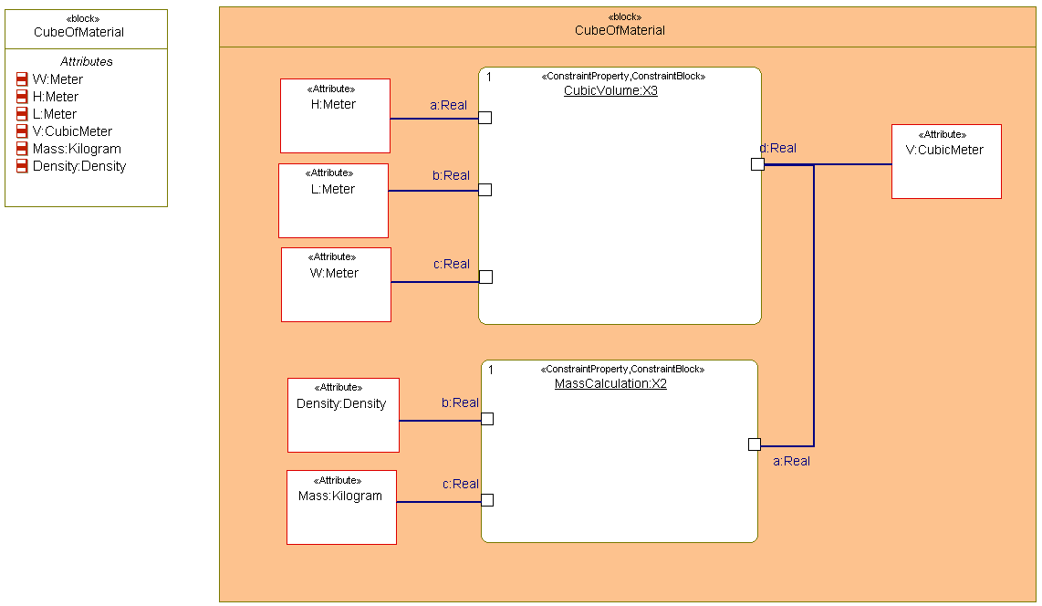
Cube of material
First you will explore the physical characteristics of a cube of material.
  Note that in this lab you will use generic Constraint Blocks and therefore Real types instead of engineering types

Slide 16
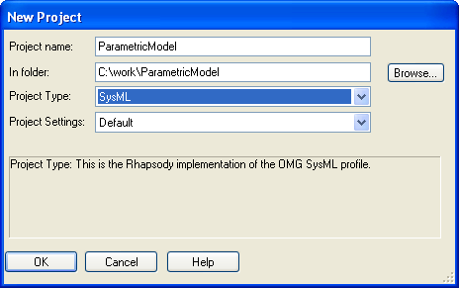
Create a new project
Launch Rational Rhapsody 7.5
Create a new SysML project: “ParametricModel”

Slide 17

Add new packages
Rename the default package:
  ParametricDefinitionsPkg
Add new packages:
  ParametricUsagesPkg
  ModelPkg
  TypesPkg

Slide 18
Tips for building a Constraint Block library
Remember that Constraints are non-causal
  F=MA == A=F/M == M=F/A
  The above three formulas can be modeled with a single Constraint.
Use the most primitive form of a mathematical relationship to get the most reuse out of it.
  Multiply2 (A=B*C) instead of F=MA
  The Constraint Property (the usage) will be called ForceCalcs or F=MA
  The only disadvantage is you should use the Real Value Type on the Constraint Parameters.
  If you do not take this approach you will have to define a very large library of Constraint Blocks for the most basic set of Constraints.

Slide 19

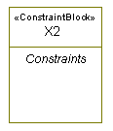
Defining Constraint Blocks
Constraint Blocks are typically defined on Block Definition Diagrams
  Add a new BDD to the ParametricDefinitions Package
    Name it Constraint Blocks
  Add a new Constraint Block
    Name it X2
  Note that you will define Constraint Blocks ‘generically’

Slide 20
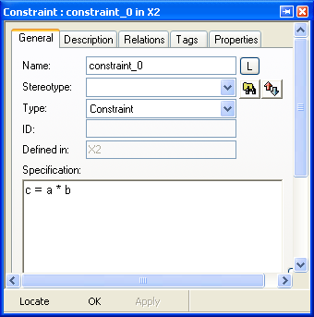
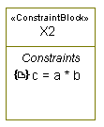

Defining Constraints
Constraints are added to Constraint Blocks in the Browser
  Locate the X2 Constraint Block in the browser
  Add a new Constraint to the Constraint Block
    Add New > General Elements > Constraint
    Leave the default name
    Use the Features View for the Constraint to give it a specification of c = a * b

Slide 21
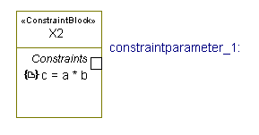
Defining Constraint Parameters
Constraint Parameters may be added:
  Via the Browser
  Via the context menu on a Diagram
  Using the diagram toolbar
On the Block Definition Diagram:
  Right-click the X2 Constraint Block
  Select Add New > Constraint Parameter

Slide 22
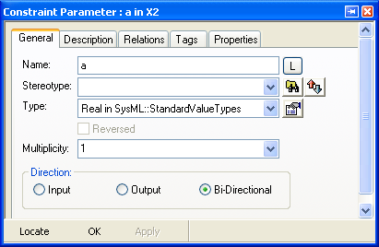
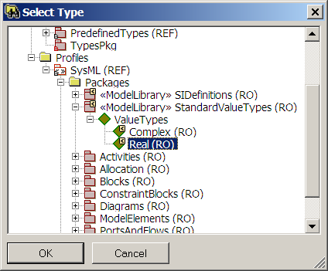
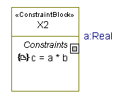
Constraint Parameter details
In the Features View for the Constraint Parameter:
  Change the name to a
  In the type selection box, select <<Select>>
  Browse to the SysML Profile and select Real in the StandardValueTypes Package

Slide 23

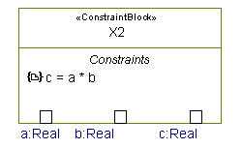
Duplicate the parameter
In the browser, right-click the a Constraint Parameter
  Select Copy
Right-click the X2 Constraint Block
  Select Paste
Rename the copies b and c

Slide 24
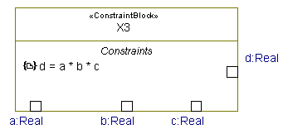
Lab: Add a X3 Constraint Block
Add a Constraint Block with a constraint of:
  d = a * b * c
Tip: Duplicate the existing X2 Constraint Block and modify the duplicate
  Change the name to X3
  Add (or duplicate) a Constraint Parameter d of type Real
  Modify the Constraint to read d = a * b * c
  Add the X3 Constraint Parameter to the BDD

Slide 25
Add a cube of material
Right-click the Parametric Usage Package
  Select Add New > Diagrams > Parametric Diagram
  Name it Cube of Material
Add a new Block to the diagram
  Name it CubeOfMaterial

Slide 26
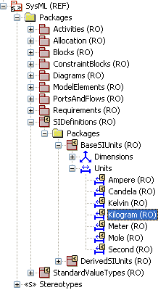
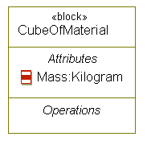
Defining an Attribute
Add a new attribute to the Block and using the Features View:
  Name it Mass
  Use the attribute type selection box to Browse for the SysML Unit Kilogram, in the package: SIDefinitions > BaseSIUnits

Slide 27
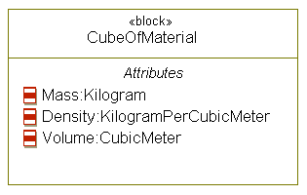
Lab: Define more Attributes
Add two more Attributes to the Cube of Material:
  Density
    Type: KilogramPerCubicMeter (found in the DerivedSIUnits Package)
  Volume
    Type: CubicMeter (also found in the DerivedSIUnits Package)

Slide 28
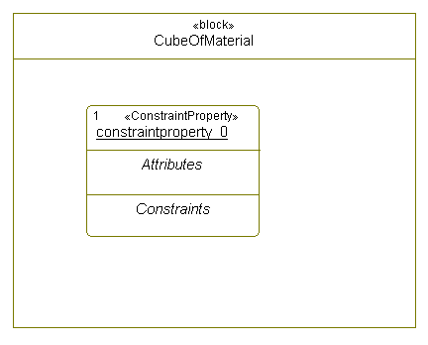
Adding a Constraint Property
Select the CubeOfMaterial and toggle it into Structure view
Use the Constraint Property tool to draw a new Constraint Property inside the CubeOfMaterial

Slide 29
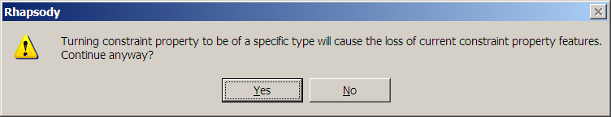
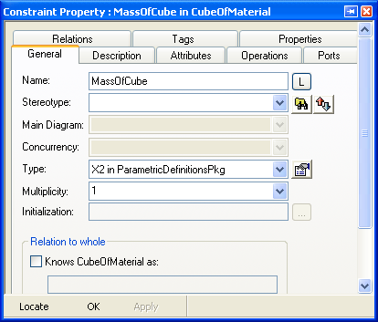
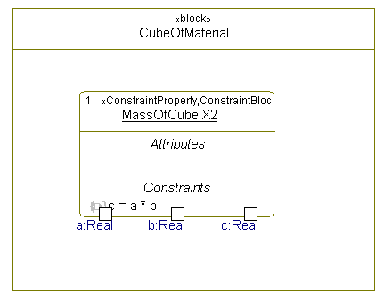
Defining the Constraint Property type
In the Features View for the new Constraint Property:
  In the type field, select the X2 Constraint Block
  Change the name to MassOfCube
  If you get prompted with this dialog click Yes
  Note that the diagram updates with the correct Constraint Parameters

Slide 30
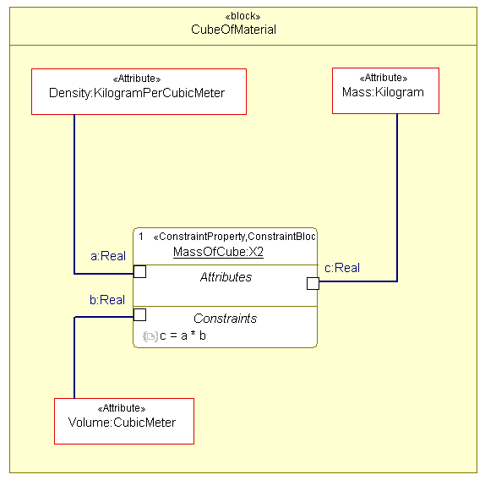
Binding Attributes
Drag the Attributes of the CubeOfMaterial Block from the Browser onto the diagram
  Use the Binding Connector tool to bind:
  Density to the Constraint Parameter a
  Volume to the Constraint Parameter b
  Mass to the Constraint Parameter c

Slide 31
Calculating Cubic Volume
Next you will add model elements to calculate the Volume of the Cube.
You will:
  Add attributes to model the length, height and width of the cube
  Add a Constraint Property based on the X3 Constraint Block
  Bind the attributes to the Constraint Parameters

Slide 32
Lab – add Attributes
Add three more attributes to the CubeOfMaterial:
  Height (H)
  Length (L)
  Width (W)
All are measured in Meters

Slide 33
Lab – Add a Constraint Property
Add a second Constraint Property to the CubeOfMaterial
  Name: CubicVolume
  Based on Constraint Block: X3
Drag on the new attributes and add Binding Connectors
  Volume = W * L * H
Note that Volume could either be bound to an attribute of the Block – or instead simply bind the Constraint Properties together

Slide 34
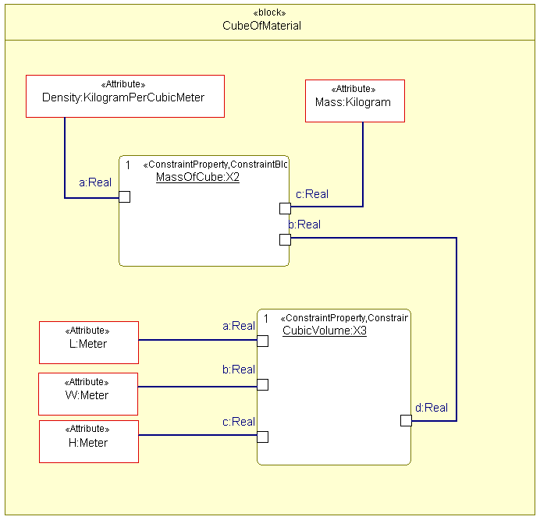
Networking Constraint Properties

Slide 35
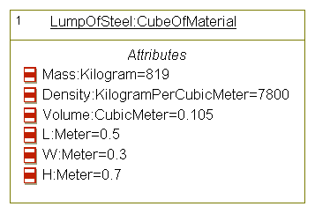
Applying actual values
In the ModelPkg, add a new IBD
  Name it Lump of Steel Example
Drag on the CubeOfMaterial
  Right-click the CubeOfMaterial and select Make a Part
  Name the Part LumpOfSteel
  Give the attributes values
  Note that Parametrics do not execute (yet)

Slide 36
Adding force
Assuming a frictionless environment - how fast will your cube travel if a hammer is applied ?
  Force = Mass * Acceleration
  You could re-use the X2 Constraint Block
  You could define a new Constraint Block using engineering types
    For this case you will need to define a new Value Type: Newton

Slide 37
SysML™ 1.0 for Systems Engineers
®
IBM Software Group
Building Type Libraries
© 2008 IBM Corporation

Slide 38
Tips for building a type library (i)
The set of defined Units, Dimensions and Types in the SysML SI definitions library is very small and only contains some of the basic types.
Building a type library for your own domain is expected.
Type libraries contain:
  Dimensions
  Units
  Value Types

Slide 39
Dimensions, Units and Value Types
Dimension
  Indicates the domain of the measurement.
Unit
  The granularity of the measurement
  Has a Dimension tag
Value Types
  Have tags to capture the dimension and unit.
    Value Types can be described in an abstract way by omitting the unit or dimension.
  Are typically designated with the standard letter used to define the variable (for example P for Pressure)

Slide 40
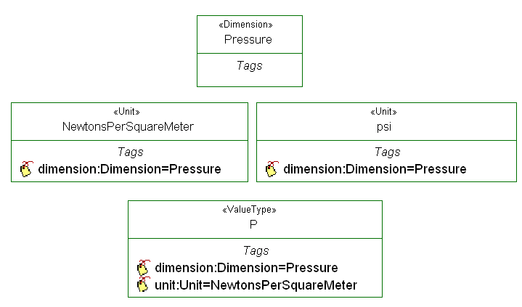
Example - Pressure
The Value Type Pressure (P):
  Is measuring Pressure the (Dimension)
  Is measured in (SI) Newtons per Square Meter (the Unit)
  Could be measured in psi or bar (non SI)

Slide 41

Add a new Dimension
Newtons are a measurement of Force
Right-click the TypesPkg and select Add New > Blocks > Dimension
  Name the Dimension: Force

Slide 42
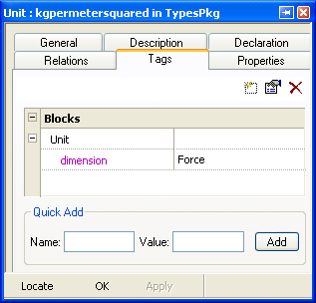

Add a new Unit
The Units of Force are kilogram-meter per second squared
Right-click the TypesPkg and select Add New > Blocks > Unit
  Name the Unit: kgpermetersquared
Using the Features View:
  Select the Tags tab
  Set the dimension tag to Force

Slide 43
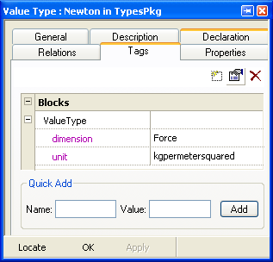
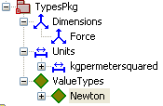
Add a new Value Type
Right-click the TypesPkg and select Add New > Blocks > Value Type
  Name the new Value Type: Newton
  Using the Features View:
    Select the Tags tab
    Set the dimension and unit tags to Force and kgpermetersquared respectively

Slide 44
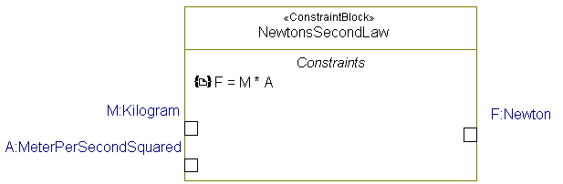
Lab: Adding force calculations
How fast will your cube travel if a hammer is applied ?
  Force = Mass * Acceleration
  You could re-use the X2 Constraint Block
  However as an example:
    Add a Constraint Block to model F = M * A
    Use engineering types instead of Real
    Tip: Call your Constraint Block ‘NewtonsSecondLaw’

Slide 45
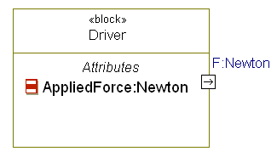

Add a driving force
Add a new Block to the ModelPkg
  Name it Driver
  Add an AppliedForce Attribute
    Note that this is a simple example and you assume a Force (an extended example would be to calculate Force by applying torque and distance T = F*D)
  Add a Flow Port typed by the Value Type Newton

Slide 46
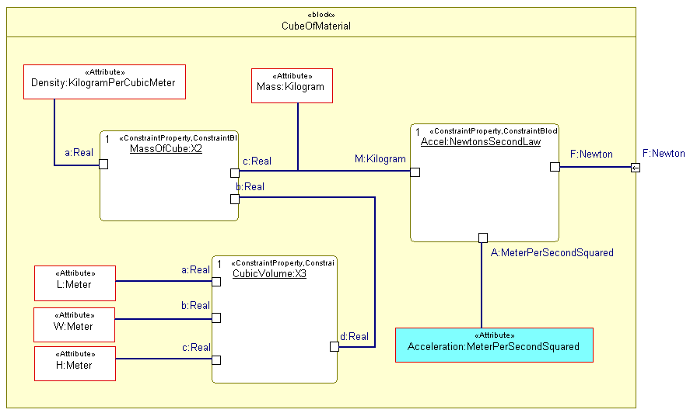
Model the driving force
Add a Constraint Property to the Cube based on NewtonsSecondLaw
  Add a Flow Port and bind the Force parameter to it.

Slide 47
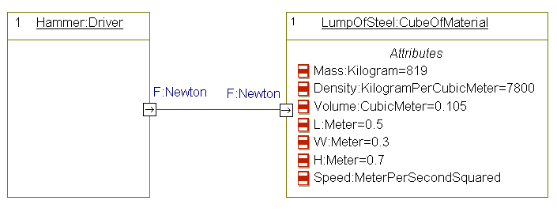
Add a Hammer
In the ModelPkg, Add a new Hammer Part – typed by the Driver Block.
  Add the Hammer to the IBD
  Connect the Flow Ports together

Slide 48
Summary
You now know how to:
Define the basic concepts of:
  Constraints
  Data types
  Value types
  Constraint block
  Constraint property
Start a new Rhapsody parametric diagram project and add constraints, define attributes and constraints
Add Dimensions, Units and Value Types to the parametric diagram

